Slide 1
Regulatory Index Tool
https://regulatory-lookup-tool-azjabpwlft46wgaqlnhdqb.streamlit.app/

Slide 2
Background
Data mining/ Data collection
Can’t find certain attributes without finding, opening, and reading through technical documents/ master data tables.
Extra hurdles: different naming conventions, different document formats (word, master data excel)

Slide 3
Background
Aim: to connect key device data such as document numbers and product codes (BUDI and SKU numbers) in a searchable format to increase efficiency of data pulling.

Slide 4
Key features
Source Data: An excel spreadsheet (easy to maintain and update)
176 TDs Listed (DePuy)
Includes data for: TD, Windchill TD number, Device name, Device Class, DoC number, BUDI-DI codes, Product codes/SKUs, SSCP, IFU, PIL, CER.
Flexible user interface.

Slide 5
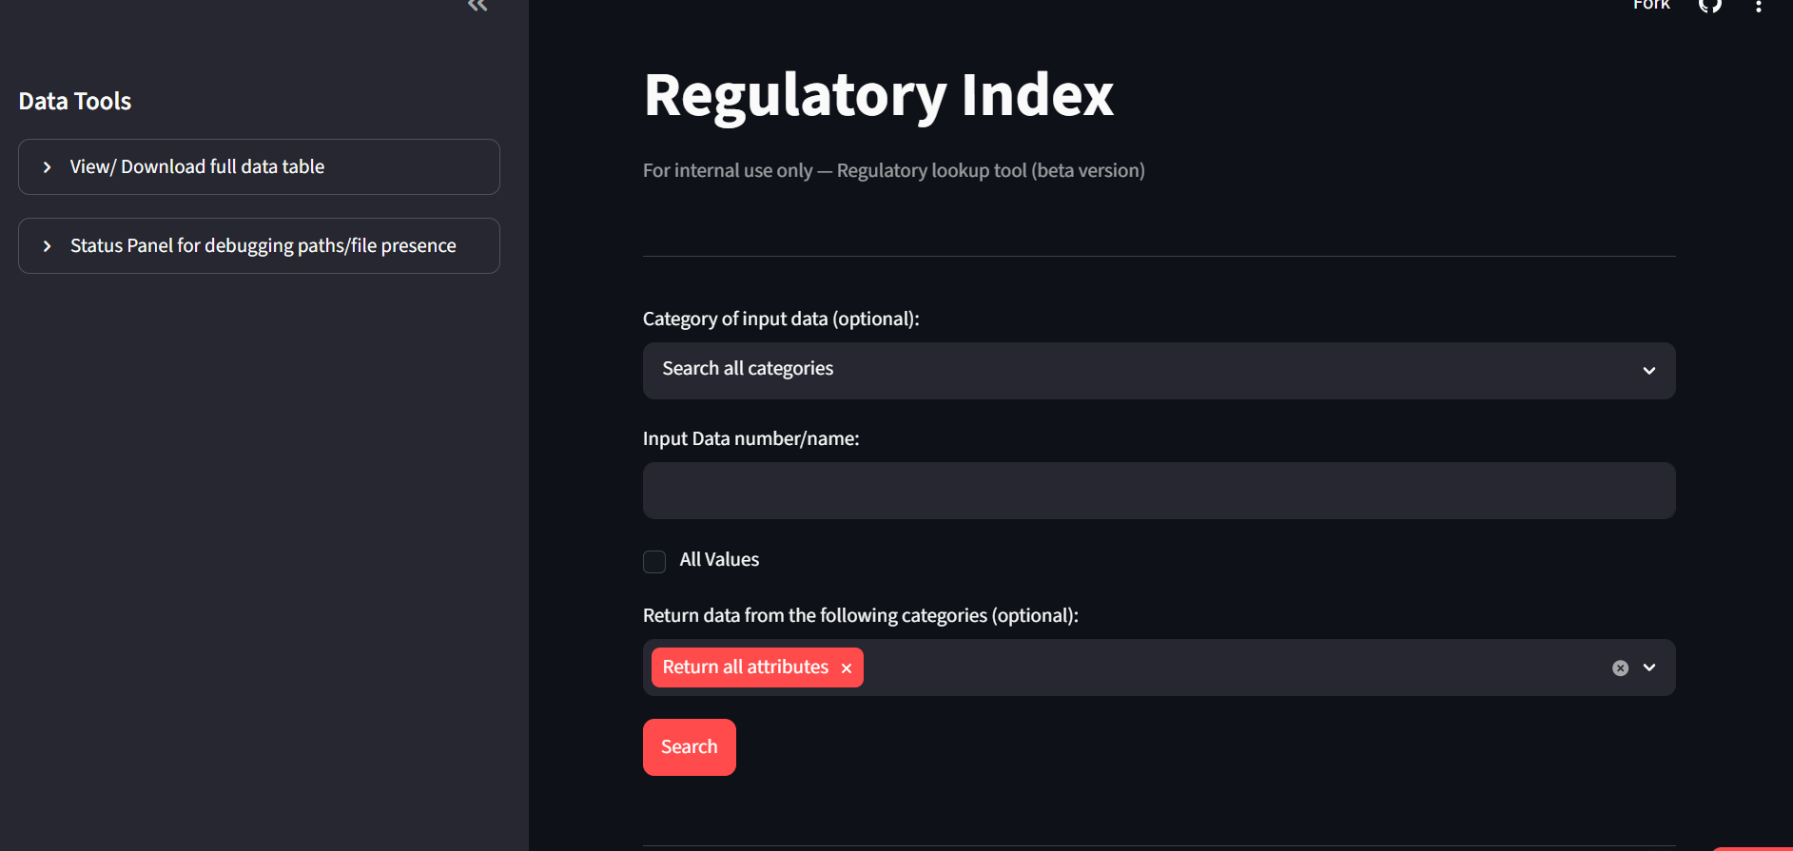
Notes:
https://regulatory-lookup-tool-azjabpwlft46wgaqlnhdqb.streamlit.app/

Slide 6
Future improvements
Fill in Data Gaps
Try a SKU-centered approach
Integrate/ link to Windchill

